Slide 1

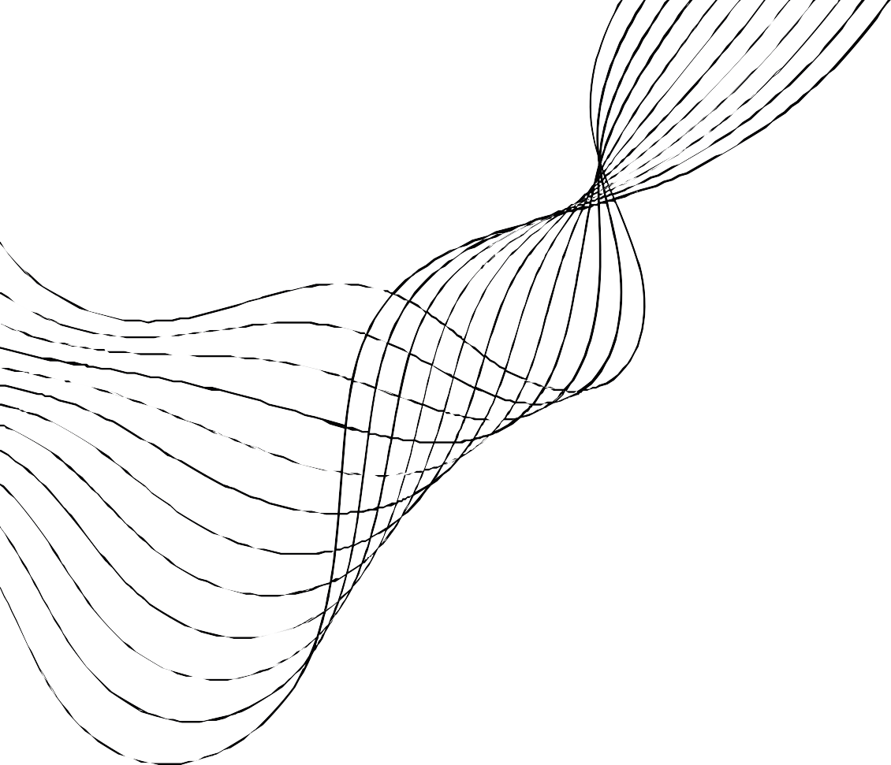
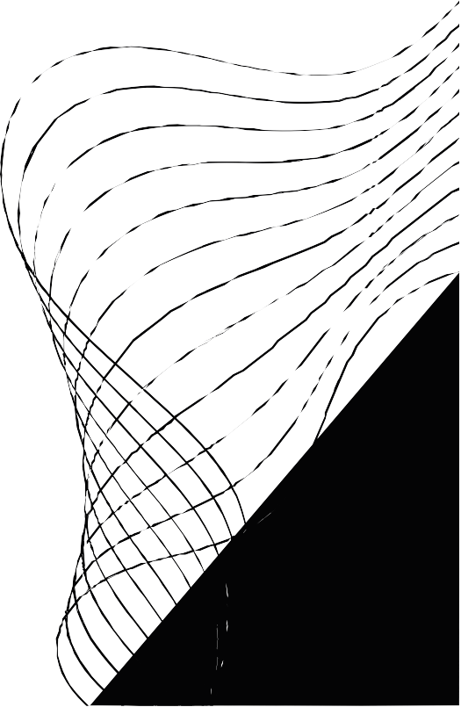
SENTIMENT ANALYSIS 0F AMAZON PRODUCT REVIEW

Slide 2
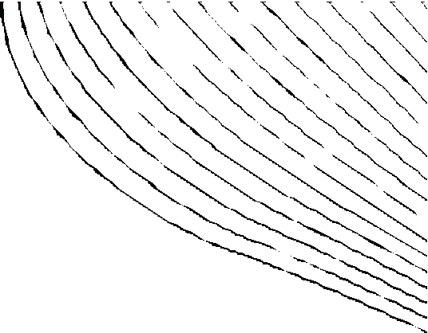

CONTENT
01
02
03
04
05
06
INTRODUCTION TO DATASET
REVIEW ANALYSIS BY MACHINE LEARNING
EVALUATION
RESULT
ADVANTAGES IN REVIEW ANALYSIS USING ML
CONCLUSION

Slide 3


INTRODUCTION
Amazon Product review analysis using machine learning employs algorithms to analyze historical sentimental data, predicting future of the products in market trends.
Techniques like text vectorization, train/test split, and Naive Bayes classification are utilized to identify patterns and make predictions.
By leveraging vast amounts of data (from dataset) and algorithms, machine learning aids Amazon in making informed decisions about how people are going to buy the product in future, if there is any need to make modification in the product.

Slide 4




REVIEW ANALYSIS
DATA- DRIVEN INSIGHTS:
Machine learning algorithms process vast amounts of historical data, identifying patterns and trends that human analysts might overlook.
This data-driven approach provides valuable insights into product’s future and market behavior.
PREDICTIVE MODELING:
Techniques such as text vectorization, train-test split, and Naïve-Bayes classification enable predictive modeling.
By analyzing historical data and market indicators, machine learning models can forecast future with varying degrees of accuracy.
ENHANCED DECISION MAKING:
Machine learning empowers firm with tools to make more informed decisions about predicting the future of the product.
By leveraging sophisticated algorithms and data analysis techniques, Amazon can develop more effective selling strategies and mitigate r isks.

Slide 5


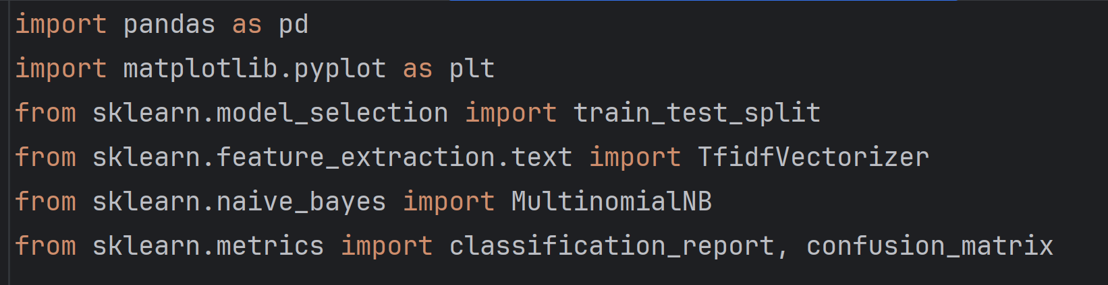
EVALUATION
Libraries used
1. pandas: Data manipulation and analysis
2. matplotlib: Data visualization
3. train_test_split: Split data into training and testing sets
4. TfidfVectorizer: Convert text to numerical features
5. MultinomialNB: Naive Bayes classifier for text classification
6. classification_report: Evaluate classification model performance
7. confusion_matrix: Analyze classification model errors

Slide 6
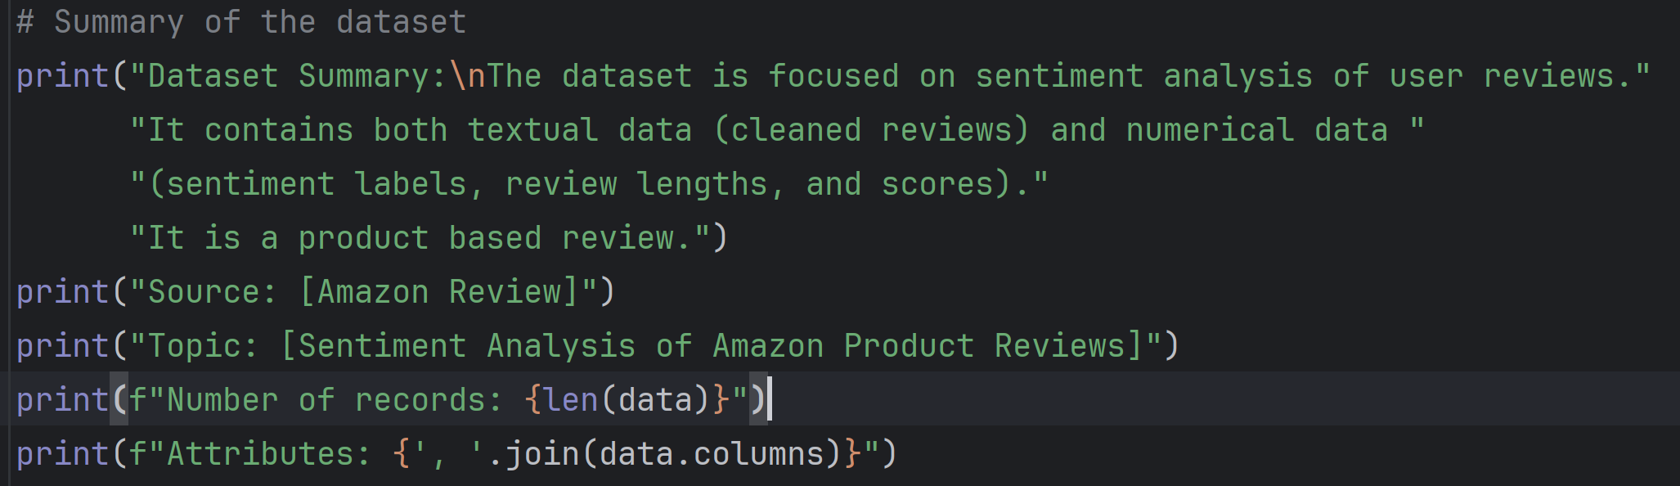
EVALUATION
Summary of data
It provides the sentiment analysis of user reviews in both textual data and numerical data.
It also provides source of data, topic, number of records taken and attributes in dataset.

Slide 7
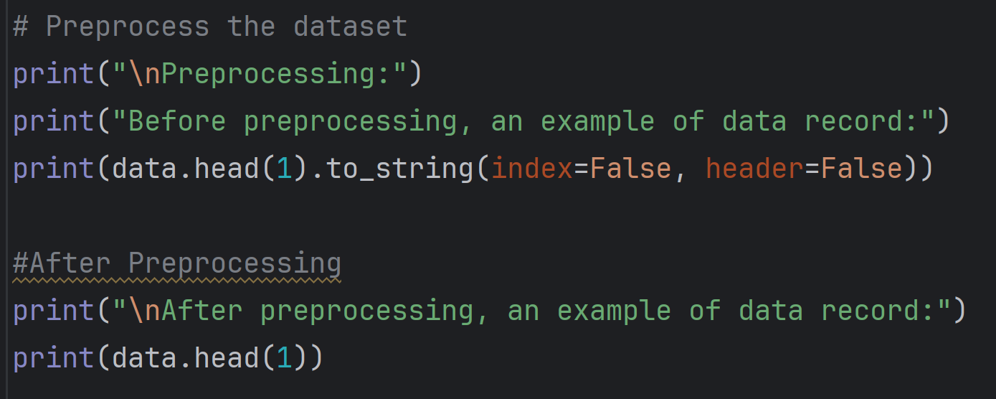
EVALUATION
Before and after Preprocessing
Before Preprocessing, the code will print a single line of output that just contain a single row of output without any additional information.
After preprocessing, output contains a single row but there is column names mentioned for each row.

Slide 8
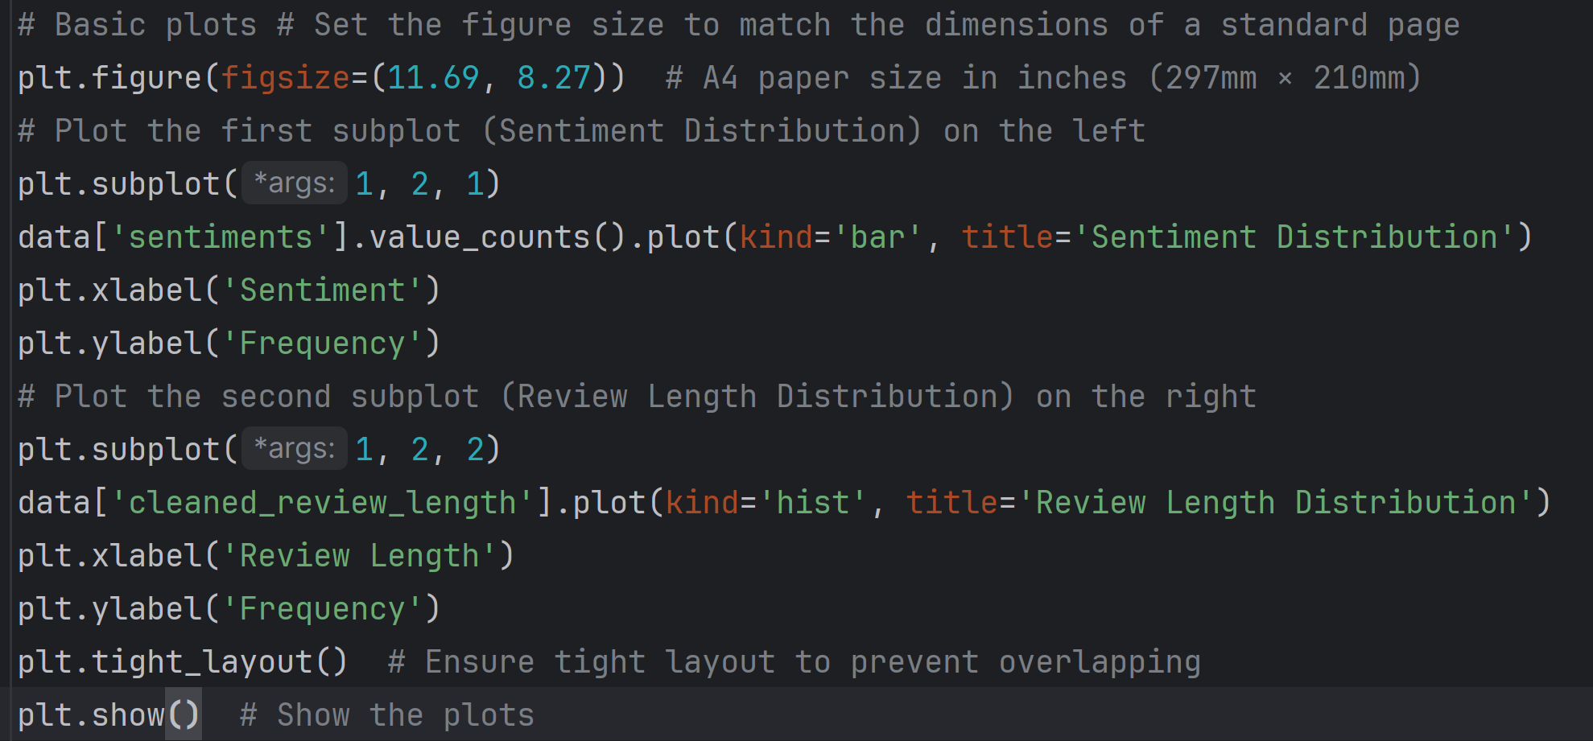
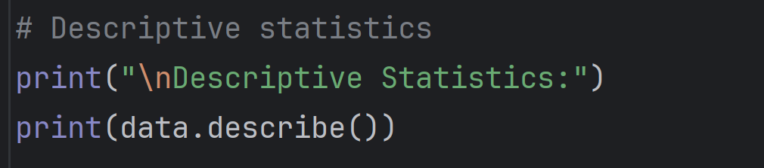
EVALUATION
Plots
The descriptive statistics part of the code provides a summary of the numerical attributes like count, mean, median, std.dev, min and max values of cleaned review data in the dataset.
A bar graph for Sentiment distribution and a Histogram of review length distribution is plotted from this code.
Overall, the plots play a vital role in data analysis by providing insights from the data that is easy for humans to process and work upon.

Slide 9
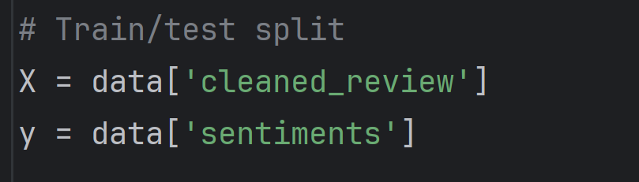
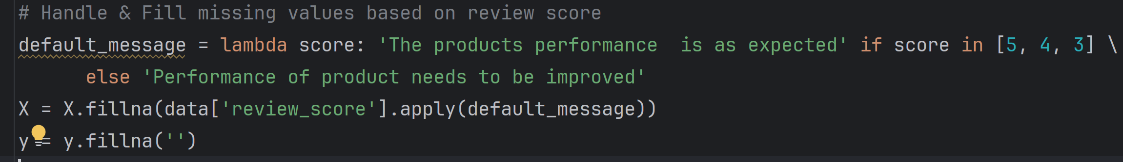
EVALUATION
Train-test model
The columns “cleaned_review” & “sentiments” are extracted from the dataset “data” and assigned to the variables X, y.
The variable ‘X’ typically represents the inputs used to make prediction and y represents he target variable that model will learn to predict.
The missing values in the columns X and y are handled based on the review score and filled with a default message.

Slide 10
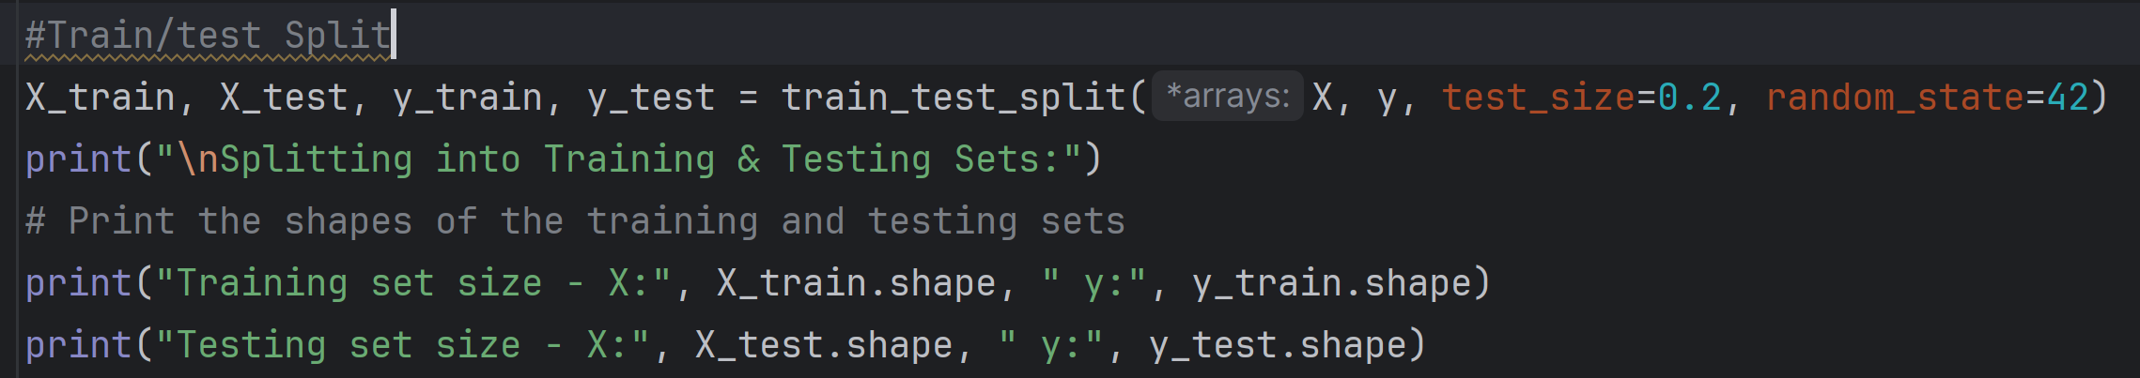
EVALUATION
Train-test model
This function train_test_split splits the dataset into training and testing sets.
The training variables X_train & y_train and the testing variables X_test, y_test hold the result dimensions of training and testing sets for both features.
The .shape attribute returns a tuple representing the shapes of the Data Frame. It prints the number of rows and columns in each set.

Slide 11
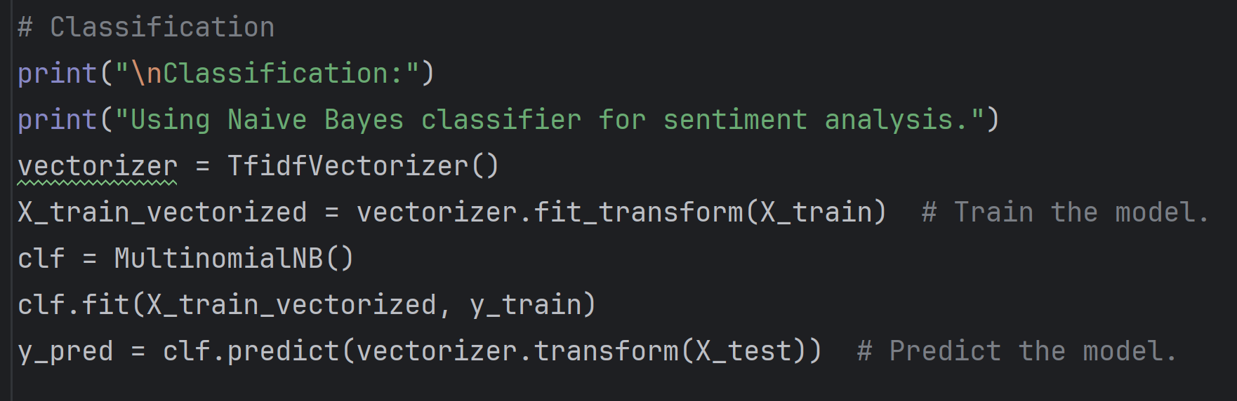
EVALUATION
Classification
Main goal of Classification is to classify each document into predefined sentiment categories, such as positive, negative, or neutral.
Naive Bayes classifier is used here for sentiment analysis which involves application of the Naive Bayes algorithm.
The TfidfVectorizer is used to transform text data into a matrix of TF-IDF features. Now the model is trained and used to predict the labels.

Slide 12
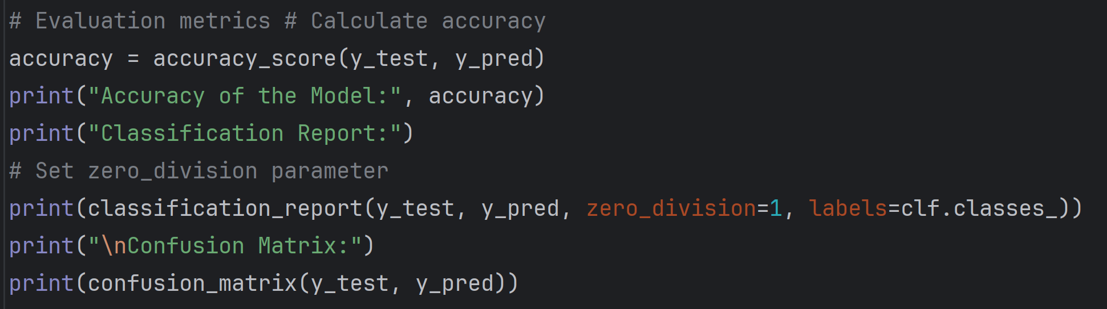
EVALUATION
Evaluation
The accuracy_score function computes the accuracy of the classification model by comparing the true labels (y_test) with the predicted labels (y_pred).
The classification_report function generates a text report showing the main evaluation metrics such as precision, recall, F1-score and support.
The confusion matrix is a table which summarizes the number of true positives, false positives, true negatives, and false negatives for each class based on the true labels (y_test) and predicted labels (y_pred) of the test set.

Slide 13
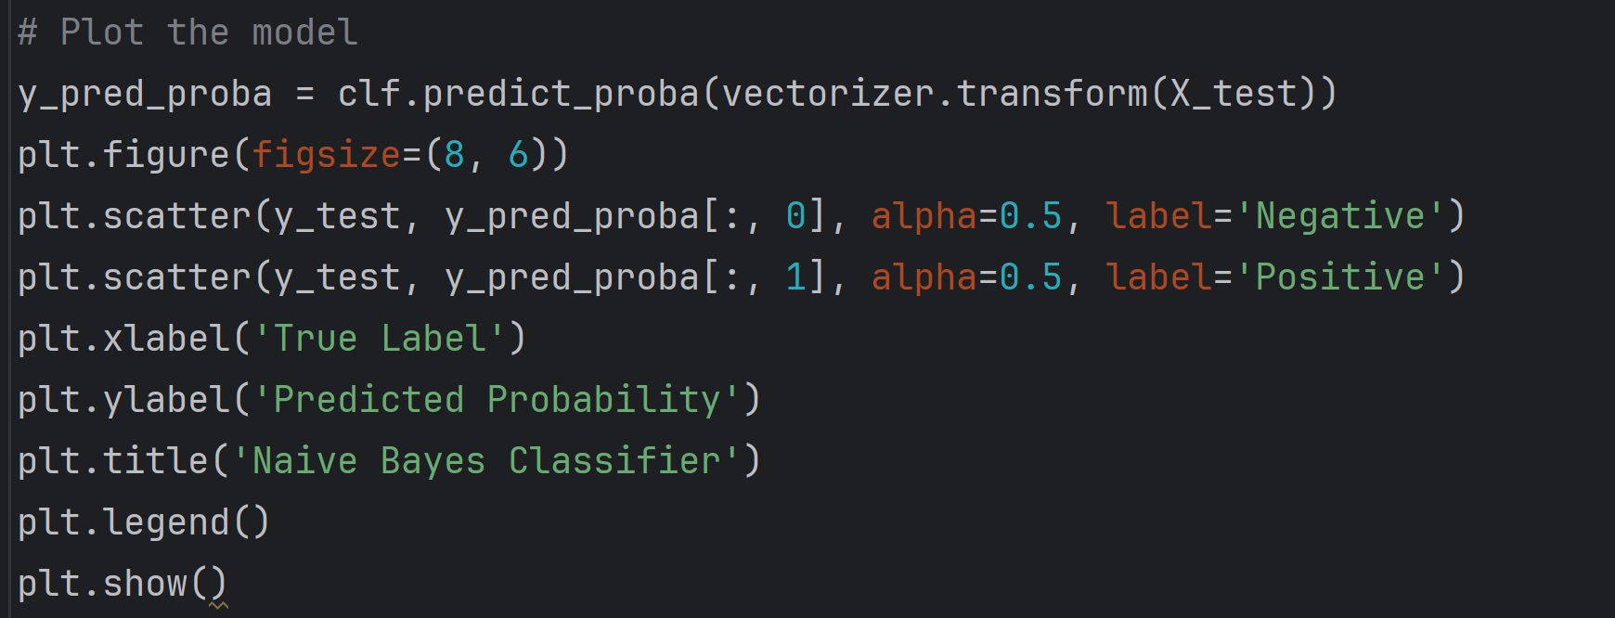
EVALUATION
Model Plot
It provides a visual representation of plotting the true labels against the predicted probabilities for both negative and positive classes
It calculates the predicted probabilities for each class (negative and positive) for the test set X_test allowing an assessment of how well the Naïve Bayes classifier is performing in terms of classification.
This graph sets the label for the x-axis as "True Label“ and label for the y-axis as "Predicted Probability“ and the title as "Naive Bayes Classifier".

Slide 14
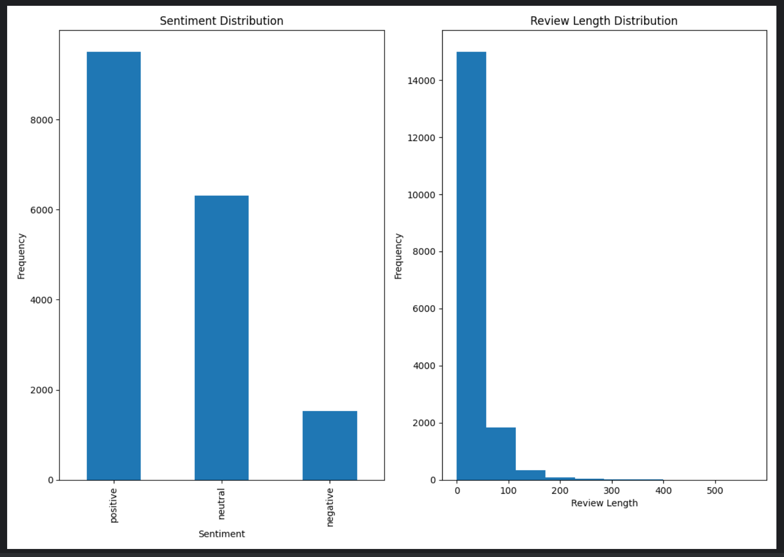
RESULT
Sentiment distribution plot:
It is a bar graph which provides insights into the balance or imbalance of sentiment classes in the dataset, which is crucial for understanding the data's overall sentiment composition.
Each bar in the plot corresponds to a sentiment category, and the height of the bar indicates the number of reviews associated with that sentiment.
Review Length Distribution Plot:
It is a histogram which helps in understanding Distribution of Review Lengths across the dataset, identifying any outliers in review lengths and determining the typical length of reviews.
Each bar in the plot corresponds to a length range, and the height of the bar indicates the number of reviews with lengths falling within that range.

Slide 15
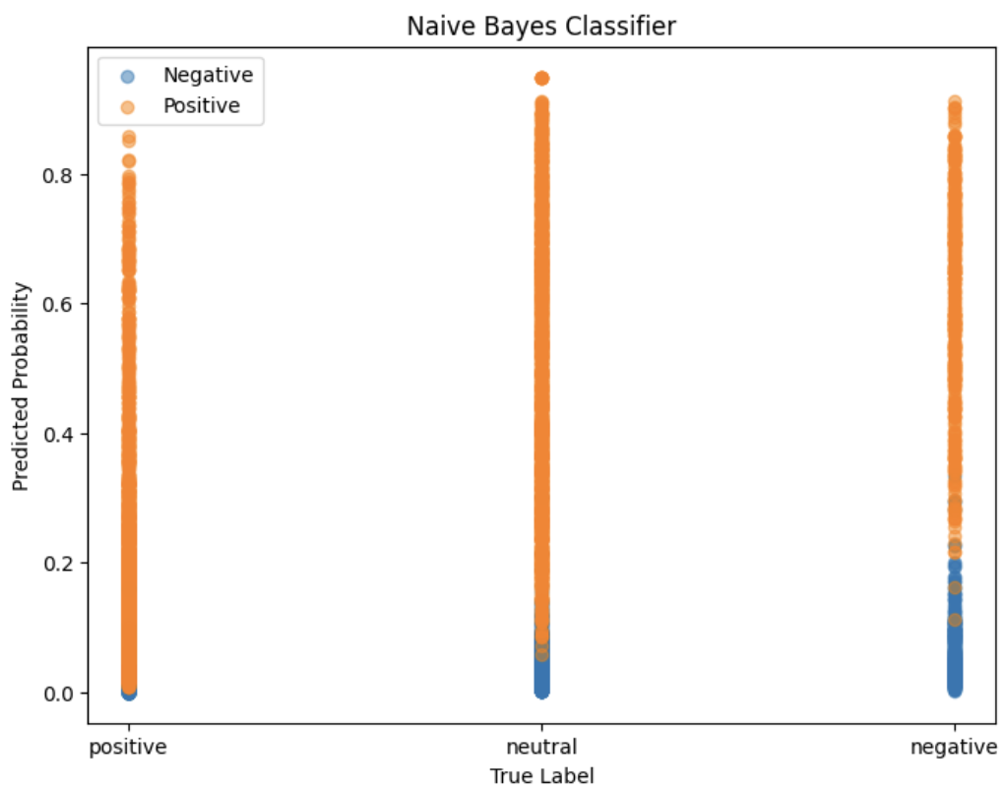
RESULT
The first scatter plot represents the predicted probabilities for the ‘Negative’ class sentiments where most points clustered towards the lower end of the probability scale, indicating high confidence in predicting negative sentiments
The second scatter plot represents the predicted probabilities for the ‘Positive’ class sentiments where most points clustered towards the higher end of the probability scale, indicating high confidence in predicting positive sentiments.
Overall, this plot visualize the predicted probabilities for the 'Negative' and 'Positive' classes in separate scatter plots which is a great way to assess the performance & provides valuable insights into the strengths and weaknesses of the Naïve Bayes classifier.

Slide 16

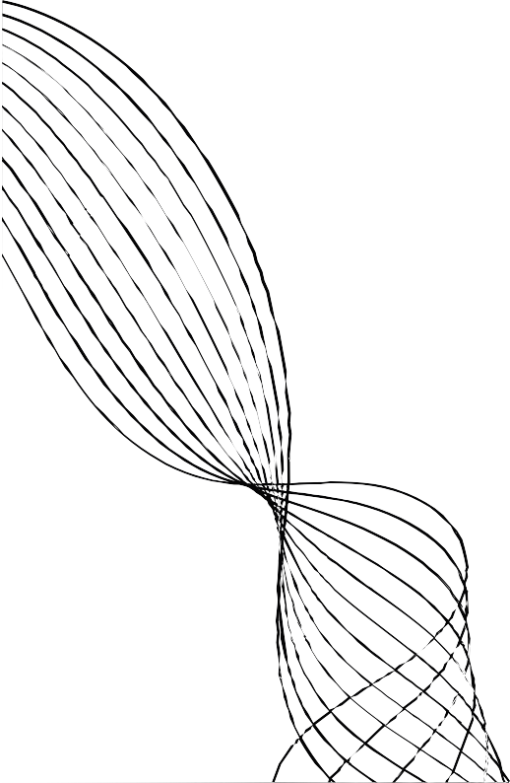

ADVANTAGES
Data-driven Decision Making:
Predictive Insights:
Efficiency and Automation:
Machine learning
algorithms analyze vast amounts of historical
Review data, enabling users to make
decisions based on objective data rather
than intuition or speculation.
By identifying patterns and trends in
historical data, machine learning models can forecast future trend of the product or market trends, assisting users in anticipating market movements and making proactive decisions.
Machine learning automates the process of data analysis, allowing users to quickly evaluate multiple reviews and develop product selling
strategies more efficiently. This automation saves time and resources, enabling
Users to focus on higher- level decision-making tasks.

Slide 17
CONCLUSION:
The provided code offers a practical approach to product
analysis using machine learning techniques. By leveraging historical data and various features such as sentiments, ratings, code predicts whether to modify or not a given product. The text vectorization, trained on these features, provides actionable insights for users. Additionally, the plotted graph visually represents the trends of sentiment and review length distribution, facilitating informed decision- making in product markets.

Slide 18
THANK YOU

